Slide 1
Carbon Monitoring and Projection: Permanent Forest Loss
Quan Shen

Slide 2
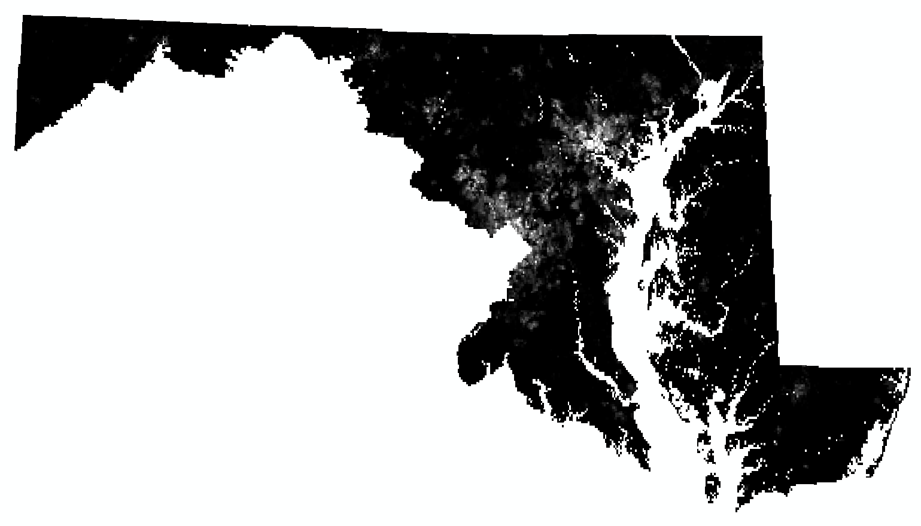

Population Density Forest Loss
Same extent, same resolution, same projection

Slide 3


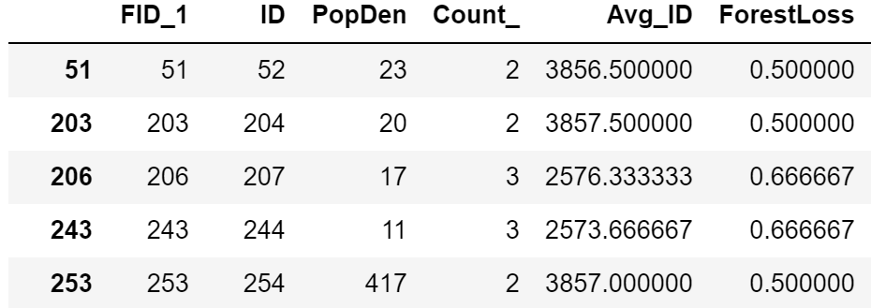
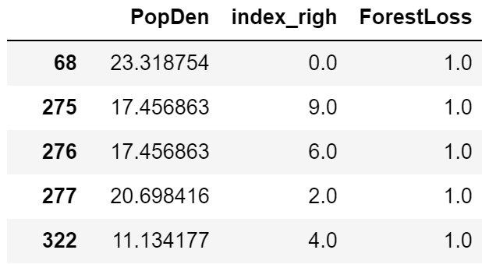
Challenge: vectorize the raster
ArcGIS
OLS
Lag Memory Error
Error Memory Error
GWR
MGWR Memory Error
Python
OLS
Lag Memory Error
Error Memory Error
GWR LinAlgError: Matrix is singular.
MGWR Memory Error

Slide 4
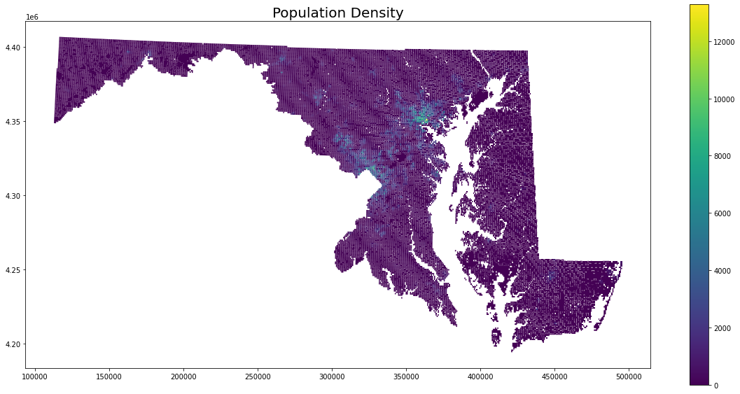
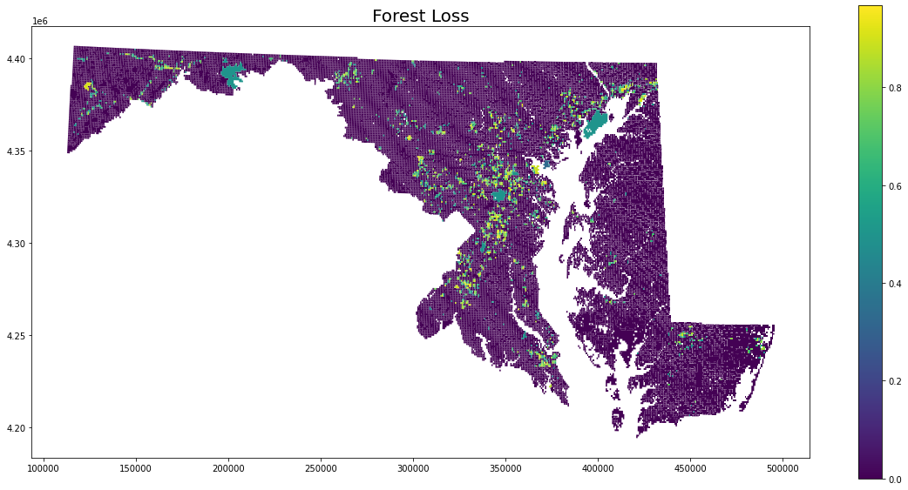
Spatial distribution
Moran’s I = 0.73
Moran’s I = 0. 33

Slide 5
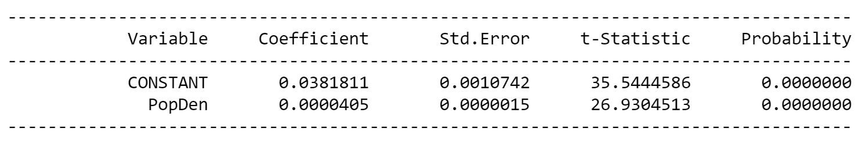
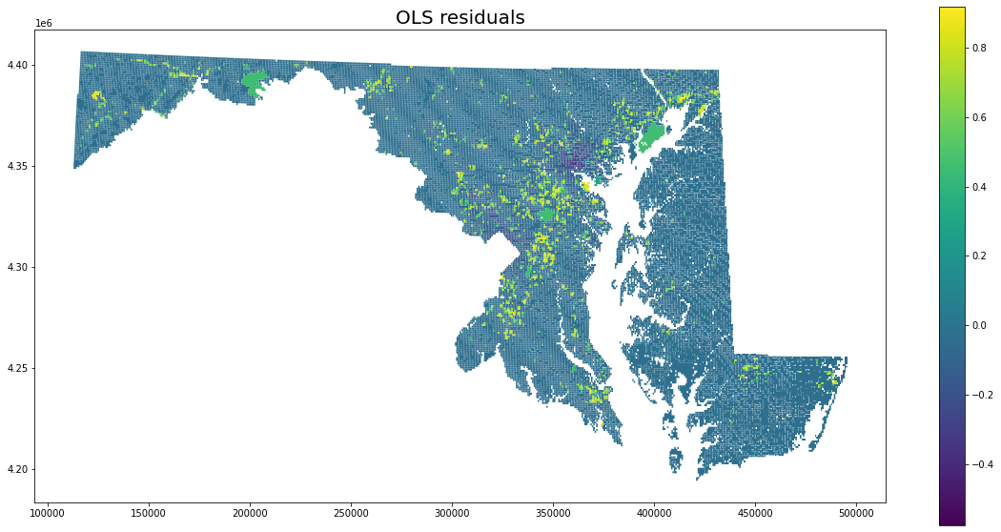
OLS
Moran’s I = 0.31

Slide 6
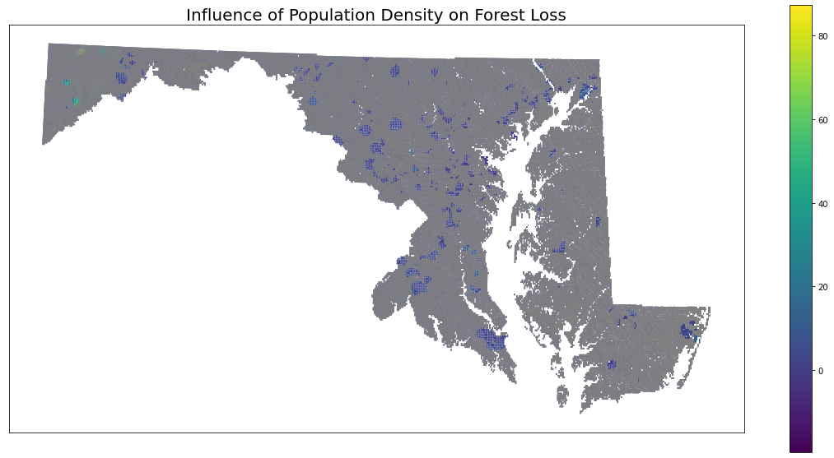
GWR
Conclusion: Will not incorporate population density. Forest loss only.

Slide 7
Timeline of next steps
11/23 → Random forest on forest loss
11/30 → Validation

